Slide 1

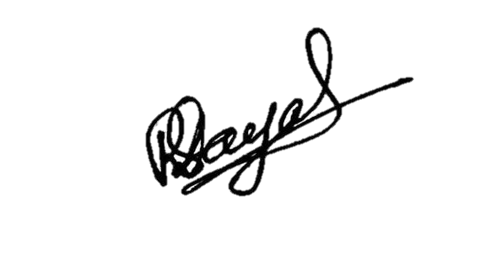
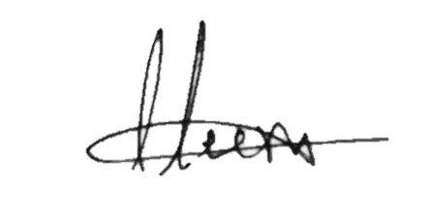
S.NO: ISM/IT/
INTERNATIONAL SCHOOL OF MANAGEMENT
Approved by AICTE (Ministry of HRD, Govt. of India)
CERTIFICATE
This is to certify that
of
has participated in the Two Day International
on the theme
Organised by Department of IT, ISM Patna
on
Head of Department
IQAC Coordinator

